Slide 1
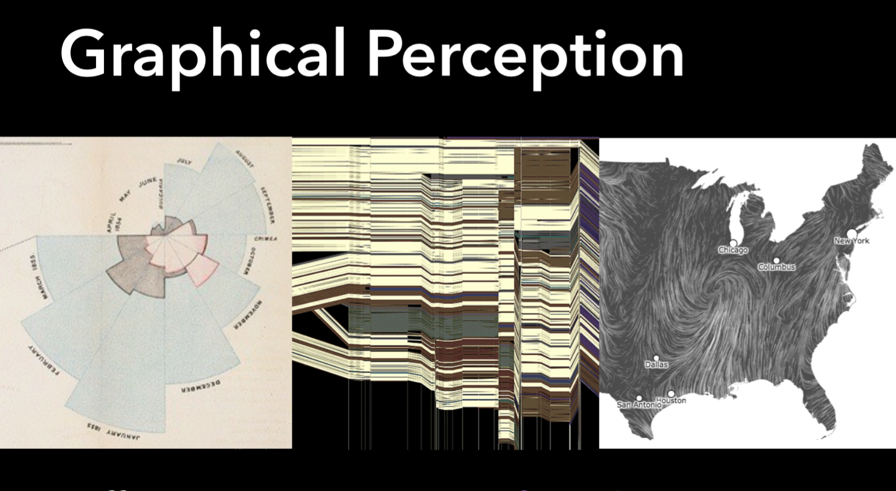

Slide 12
Notes:
https://www.khanacademy.org/science/health-and-medicine/nervous-system-and-sensory-infor/sensory-perception-2014-03-27T18:45:20.451Z/v/webers-law-and-thresholds

Slide 23
What if there was a gap between mapped data and our perception of it?

Slide 24
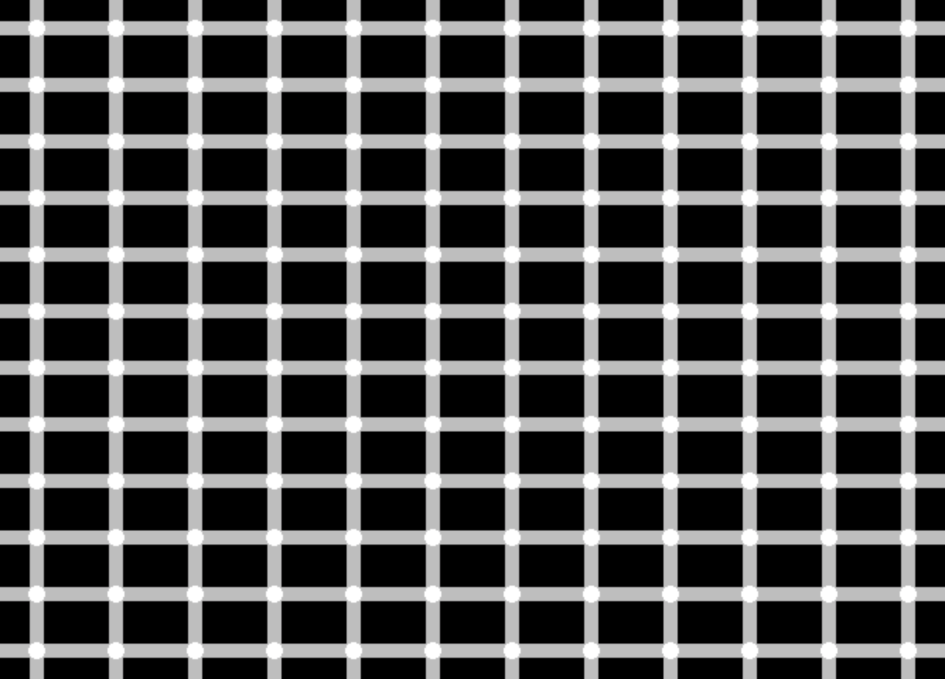

Slide 25
Black dots at the intersections appear and disappear; are they real?

Slide 26
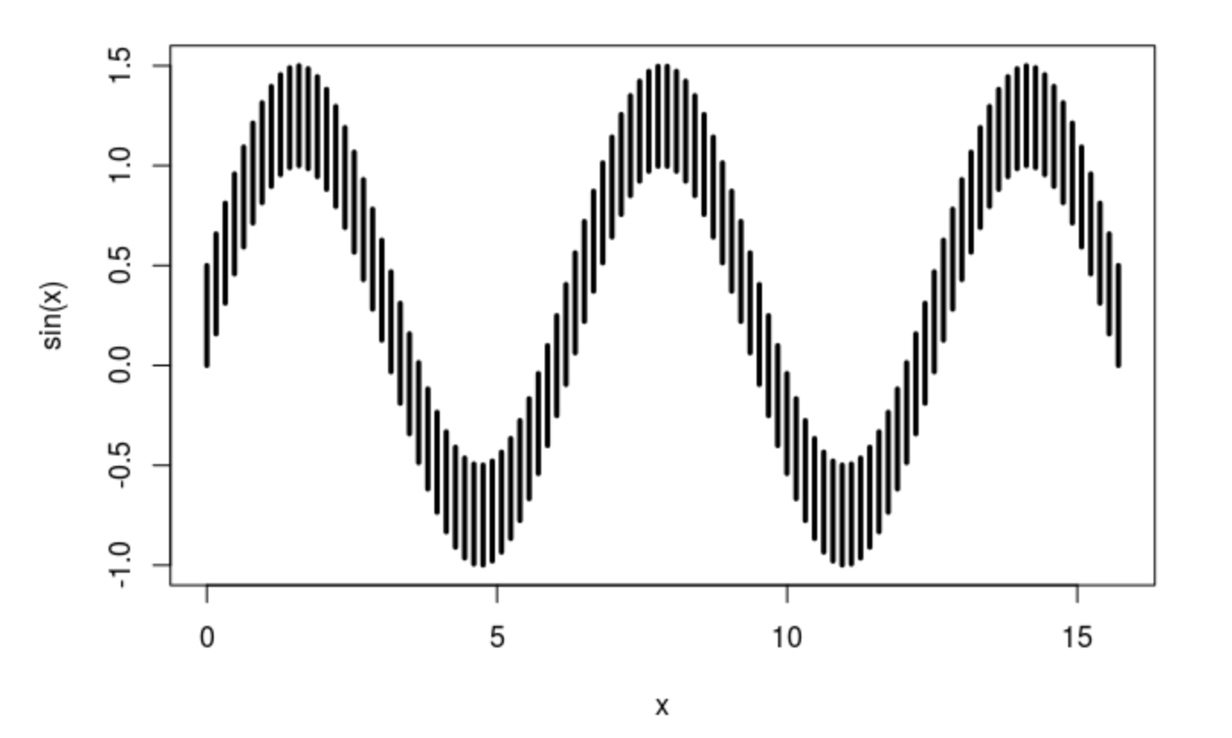
The sine Illusion: which of the bars are longer, or are they the same length?

Slide 27
What if there was a gap between mapped data and our perception of it?
Psychophysics relates “matter to the mind, by describing the relationship between the world and the way it is perceived.” Psychophysical studies select specific sensory stimuli and evaluate human perception of the stimuli.

Slide 28
What if there was a gap between mapped data and our perception of it?
Cartographers studied thresholds (what is the smallest type size the average viewer can read?), discrimination (what is the minimum difference between two gray tones required for the average viewer to perceive a difference?), and scaling (how to scale a map symbol so the average user correctly judges the symbol’s value?).
The most studied map symbol was the proportionally scaled circle.

Slide 29
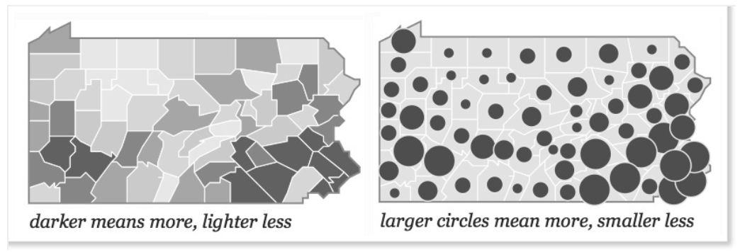
James Flannery’s primary research used psychophysical methodology - it focused on map symbols and was based on 1920s research on the human perception of circles and other symbols on statistical graphics.

Slide 30
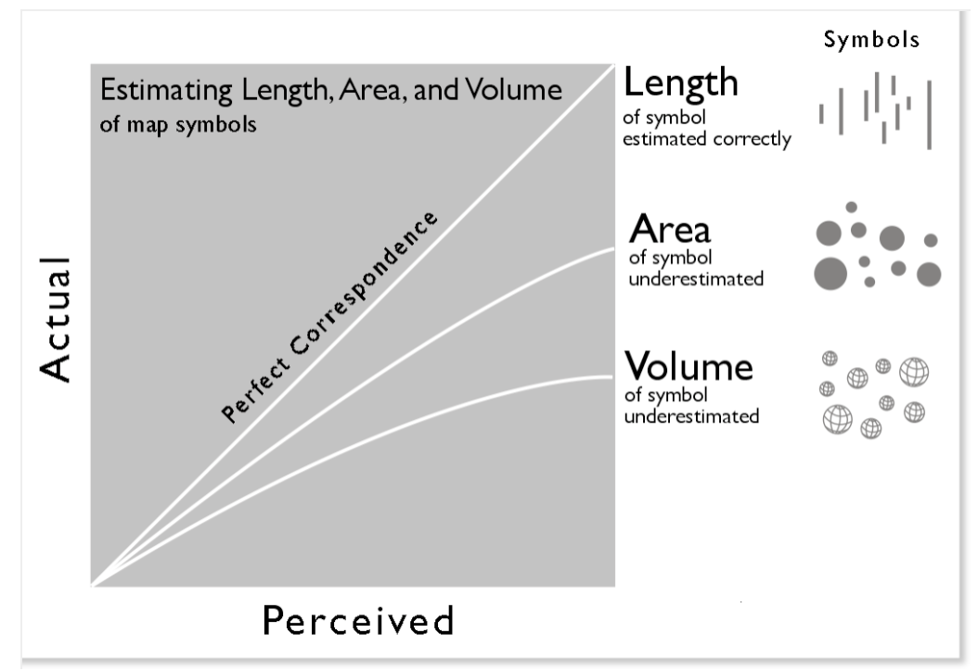
But psychophysical research revealed that while people tend to correctly estimate lengths, they tend to underestimate areas and volumes
Notes:
The absolute scaling of circles is common on proportional circle maps: a county with a value of 100 has a circle with an area of 2 square cm, a county with a value of 200 has a circle with an area of 4 square cm, etc. (In 1801 William Playfair first scaled circle areas to represent quantities; the use of area rather than diameter persists to this day).
But psychophysical research revealed that while people tend to correctly estimate lengths,they tend to underestimate areas and volumes. In other words, when asked to pick a circle that is two times the size of another in a range of different circle sizes, most people would pick a circle that was about 1.8 times the size. This tendency gets worse with larger areas, and is worse in general for estimations of volumes.
The graph below shows three apparent-magnitude curves for estimations of symbol length, area, and volume.

Slide 31
Notes:
The implication of this perceptual underestimation was that absolute scaling on proportional symbol maps led to inaccurate perception of the values: while the circles were scaled accurately, the perception of the areas, and thus the values the user got from the map, were wrong.
The solution was to devise a method of perceptual (or apparent) scaling of graduated symbols, or appearance compensation in ArcGIS-ese.
Thousands of perceptual tests led Flannery to develop a method for scaling circles that compensated for the underestimation. When you check the Appearance Compensationcheck box in ArcGIS the method scales up proportional circles, the larger the circle, the more the scaling.
Edward Tufte, in The Visual Display of Quantitative Information (1998, 2nd ed. 2001) stands opposed to anything but absolute scaling: “The representation of numbers, as physically measured on the surface of the graphic itself, should be directly proportional to the numerical quantities represented” (see my previous post on Tufte here). If one actually measures a perceptually scaled circle on a map (or graph) one would get the wrong actual value. Tufte’s demand to “tell the truth about data” excludes compensation for human perceptual failings. In one fell swoop Tufte wiped out a broad swath of psychophysical research in cartography.
The fact that perceptual (or apparent) scaling was based on an average subject ignored the fact that a broad range of user reactions varied greatly from the average. Perceptual adjustments for the average subject didn’t solve the perceptual problem for a considerable number of potential map users, and led to problems for those who were able to correctly judge areas.
Finally, once added to the complexity of a map, the value of apparent scaling diminished. Research revealed the perceptual problem was not as evident on maps with a smaller range of circle sizes; that good legend design could eliminate the perceptual problem; and that circles on complex maps may have other problems, including optical illusions, which are impossible to correct and lead to even worse perceptual problems. For example, the middle circle in the two groups below is the same size (showing how the perceived area of a circle is shaped by the circles that surround it):

Slide 34
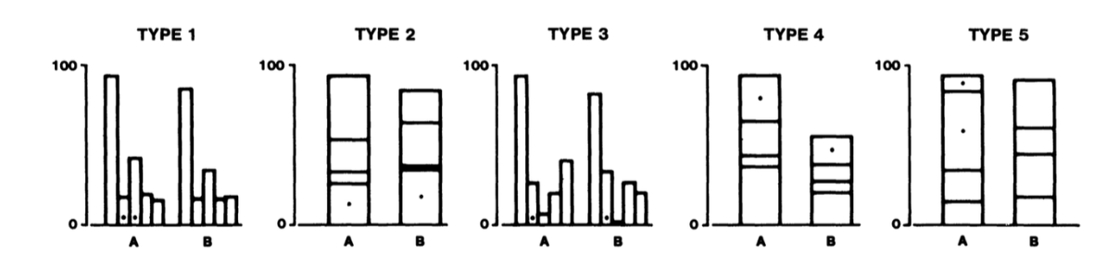
Graphical Perception (Cleveland and McGill 1984)
The tasks: For each setting
Identify which of two marked items is smaller.
Estimate the percentage the smaller is of the larger.

Slide 35
Graphical Perception (Cleveland and McGill 1984)
Notes:
They tested pie charts too

Slide 36
Notes:
In Type 5, you're comparing lengths that are stacked rather than next to each other. The results show that these are the most difficult, producing the highest error.
Here are confidence intervals (same thing I've used in the recent pie charts postings) for error. Check out types 4 and 5!
The latter are clearly worse than the first three. The confidence intervals clearly don't overlap. The error metric used in the paper is also based on the logarithm, so the differences here are pretty large.
But Cleveland and McGill also tested pie charts. Let's see how pie charts do in comparison. I've highlighted them in the full version of the results.
Stacked bar charts have higher error than pie charts (angle condition, even though we now know that it's not angle)! The basic bar charts are clearly better than pie charts, but stack them and they're worse! Both stacked configurations are worse than pie charts, but especially the one where you're comparing bars that sit on top of each other.
There are also other studies that have found the same or similar results.

Slide 40
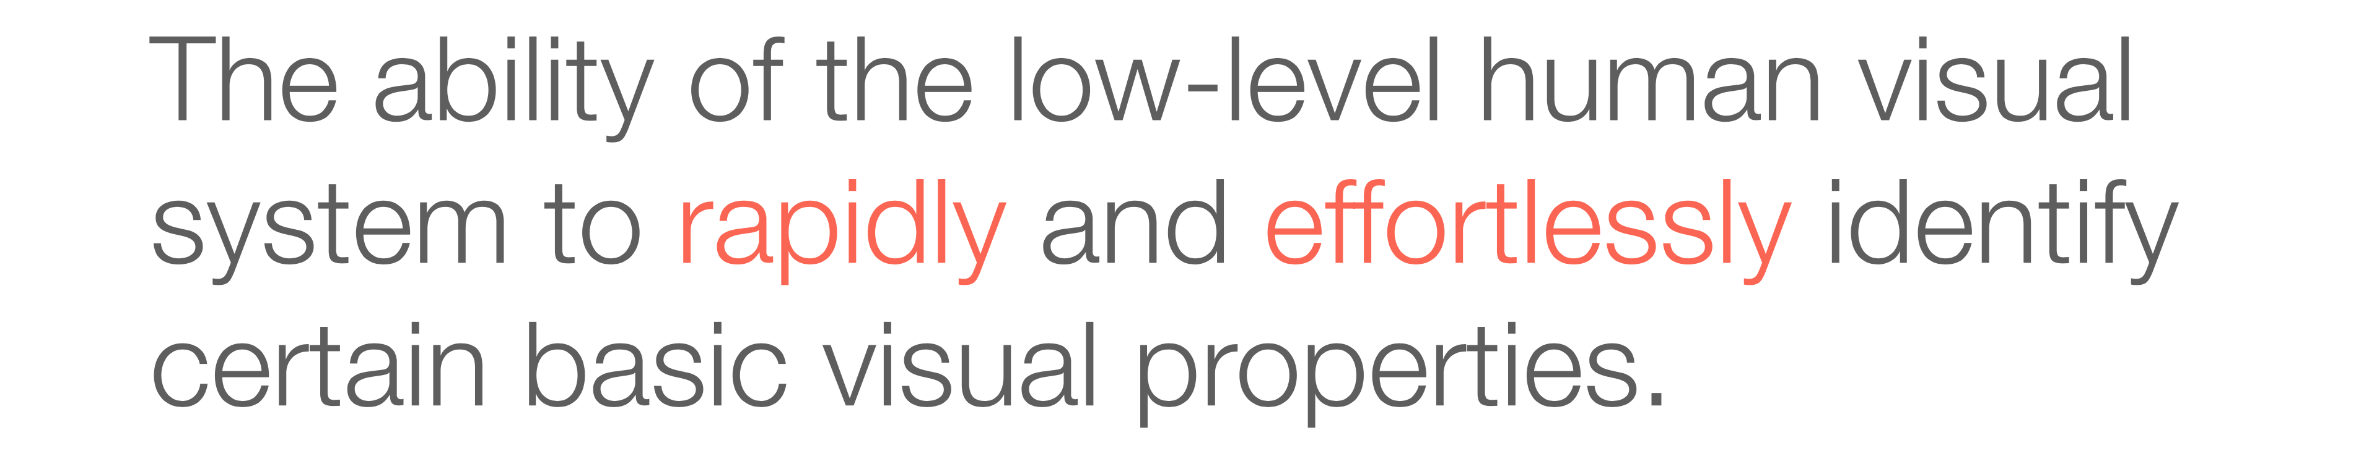

Slide 49
Notes:
According to Treisman, the first stage of the feature integration theory is the preattentive stage. During this stage, different parts of the brain automatically gather information about basic features (colors, shape, movement) that are found in the visual field. The idea that features are automatically separated appears to be counterintuitive; however, we are not aware of this process because it occurs early in perceptual processing, before we become conscious of the object.
The second stage of the feature integration theory is the focused attention stage, where the individual features of an object combine in order to perceive the whole object. In order to combine the individual features of an object, attention is required and selection of that object occurs within a "master map" of locations. The master map of locations contains all of the locations in which features have been detected, with each location in the master map having access to the multiple feature maps. When attention is focused at a particular location on the map, the features currently in that position are attended to and are stored in "object files". If the object is familiar, associations are made between the object and prior knowledge, which results in identification of that object. In support of this stage, researchers often refer to patients suffering from Balint's syndrome. Due to damage in the parietal lobe, these people are unable to focus attention on individual objects. Given a stimulus that requires combining features, people suffering from Balint's syndrome are unable to focus attention long enough to combine the features, providing support for this stage of the theory.
Treisman distinguishes between two kinds of visual search tasks, "feature search" and "conjunction search". Feature searches can be performed fast and pre-attentively for targets defined by only one feature, such as color, shape, perceived direction of lighting, movement, or orientation. Features should "pop out" during search and should be able to form illusory conjunctions. Conversely, conjunction searches occur with the combination of two or more features and are identified serially. Conjunction search is much slower than feature search and requires conscious attention and effort. In multiple experiments, some referenced in this article, Treisman concluded that color, orientation, and intensity are features for which feature searches may be performed.

Slide 56
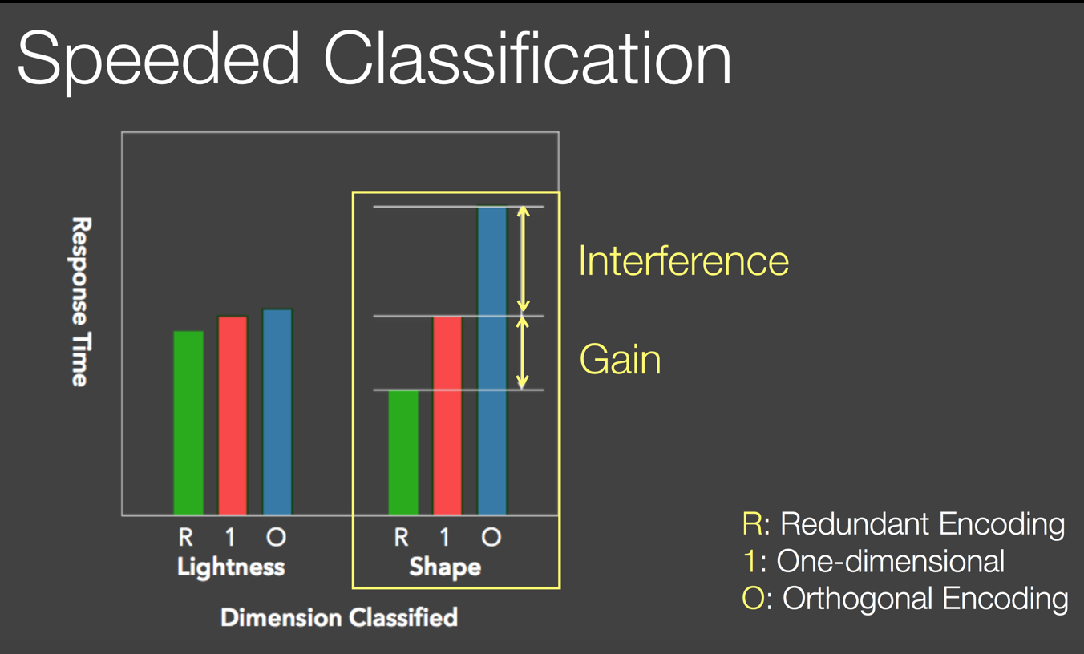

Slide 57
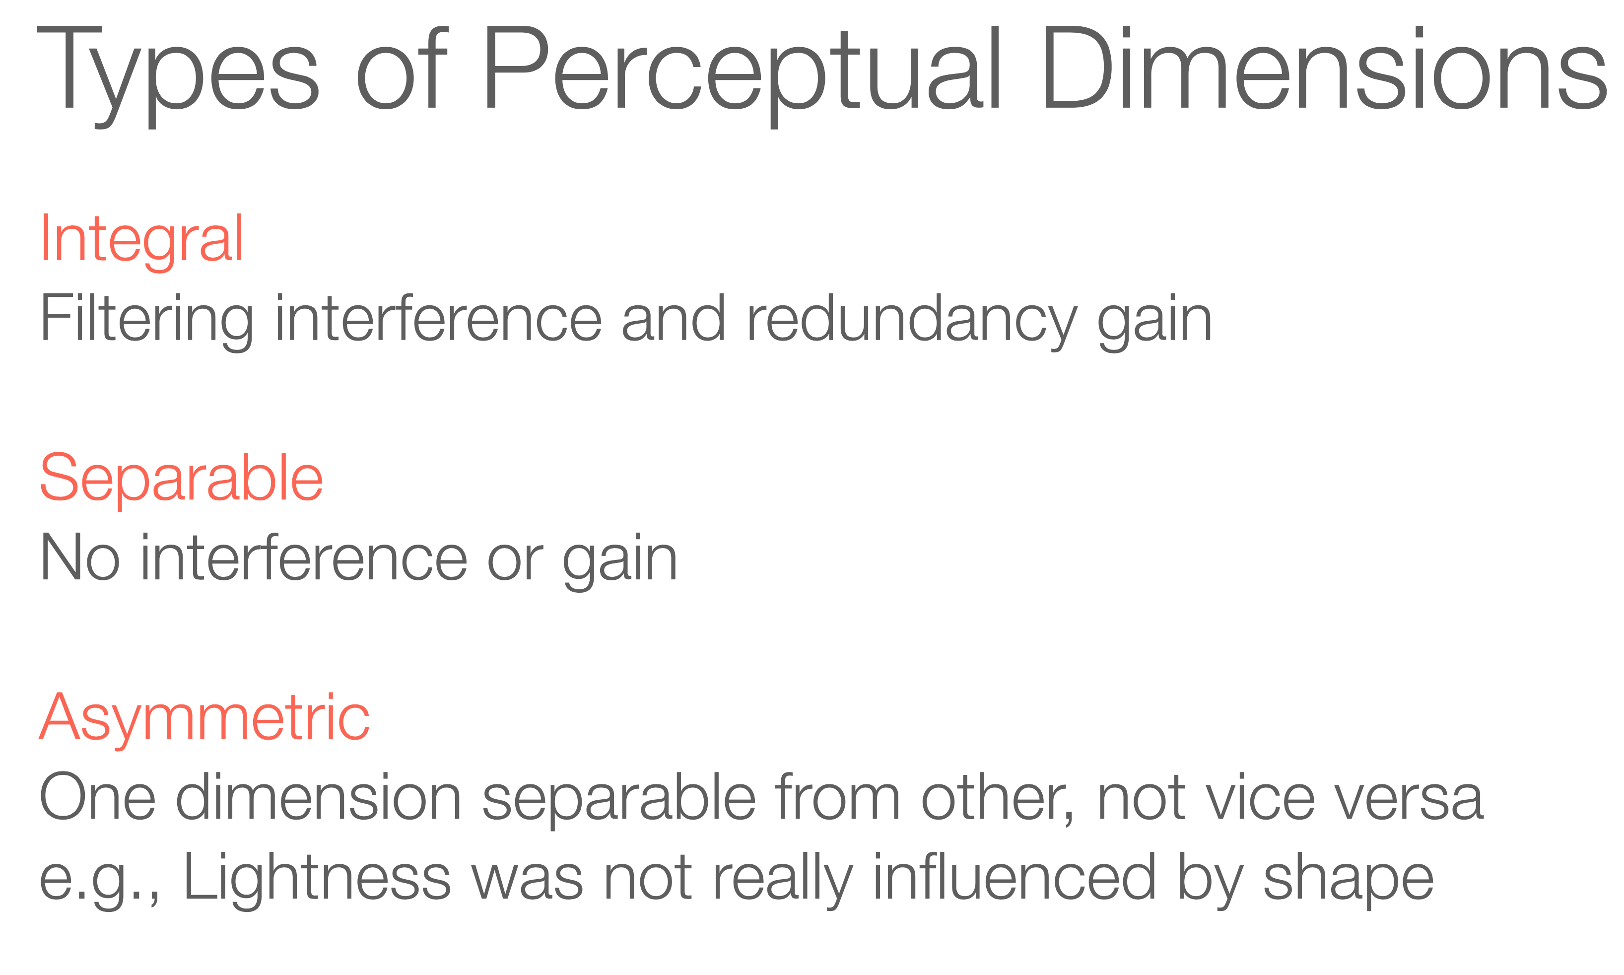

Slide 58
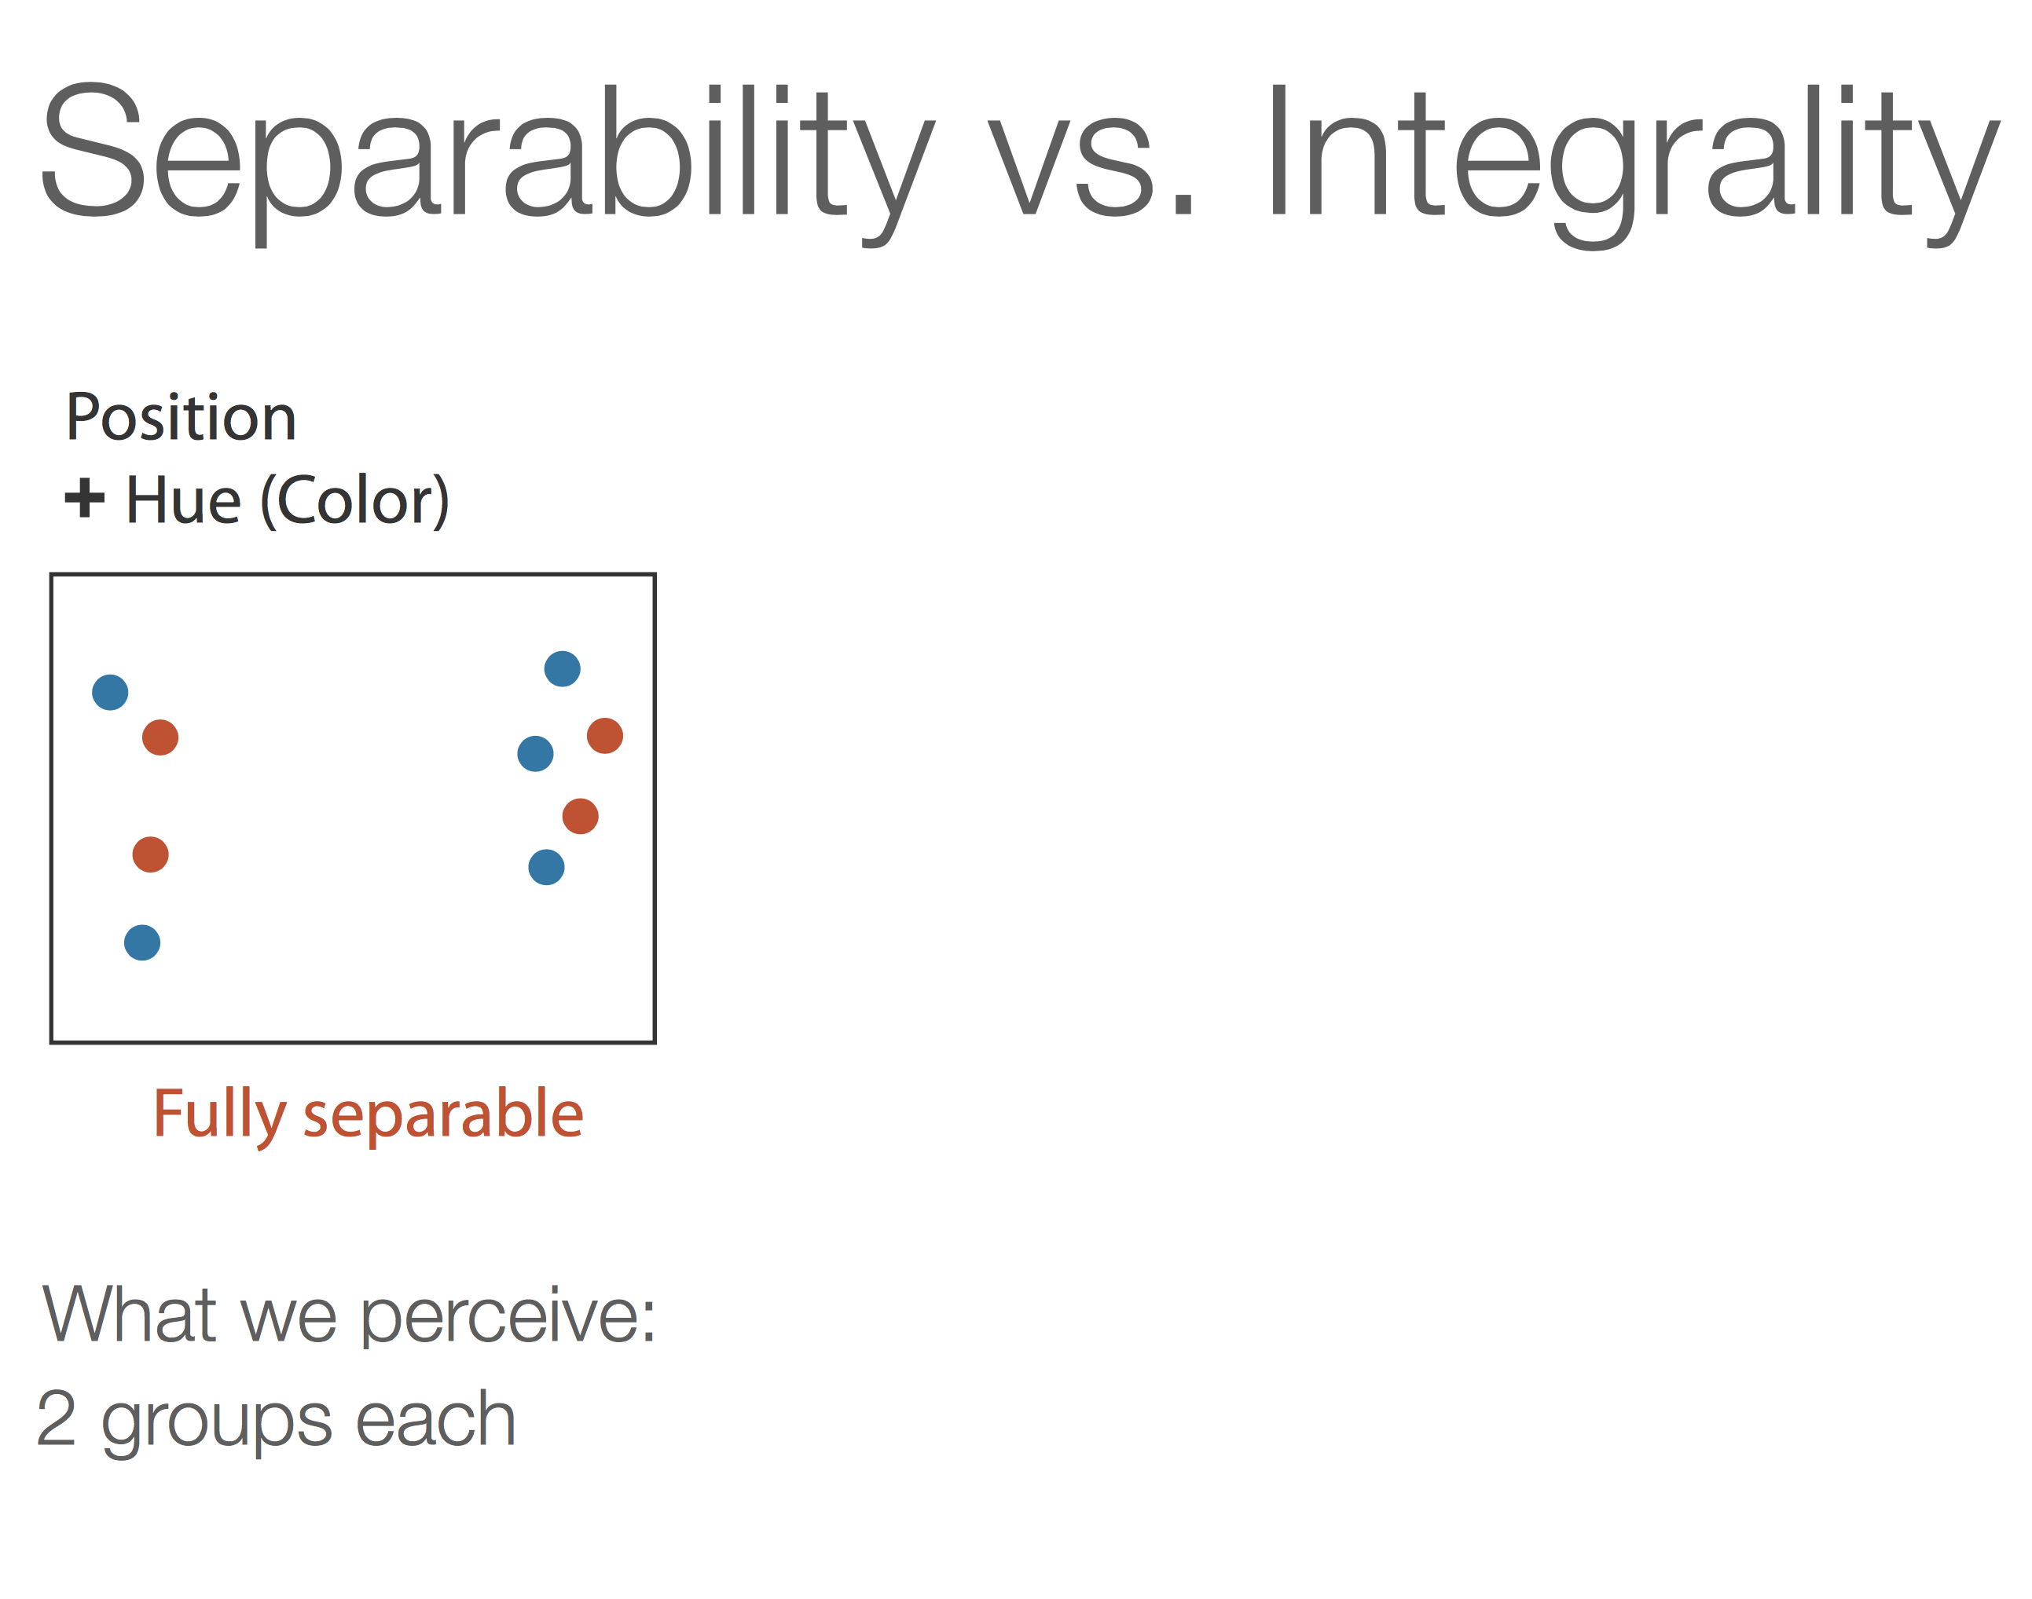

Slide 59
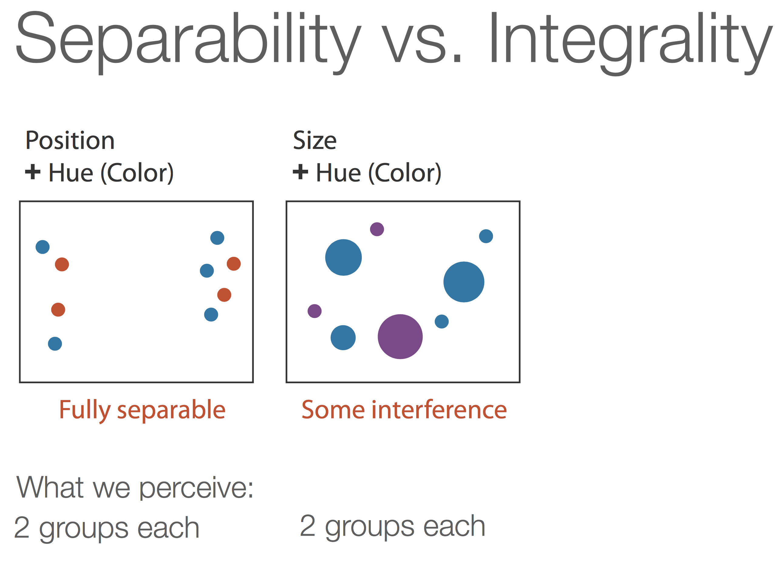

Slide 60
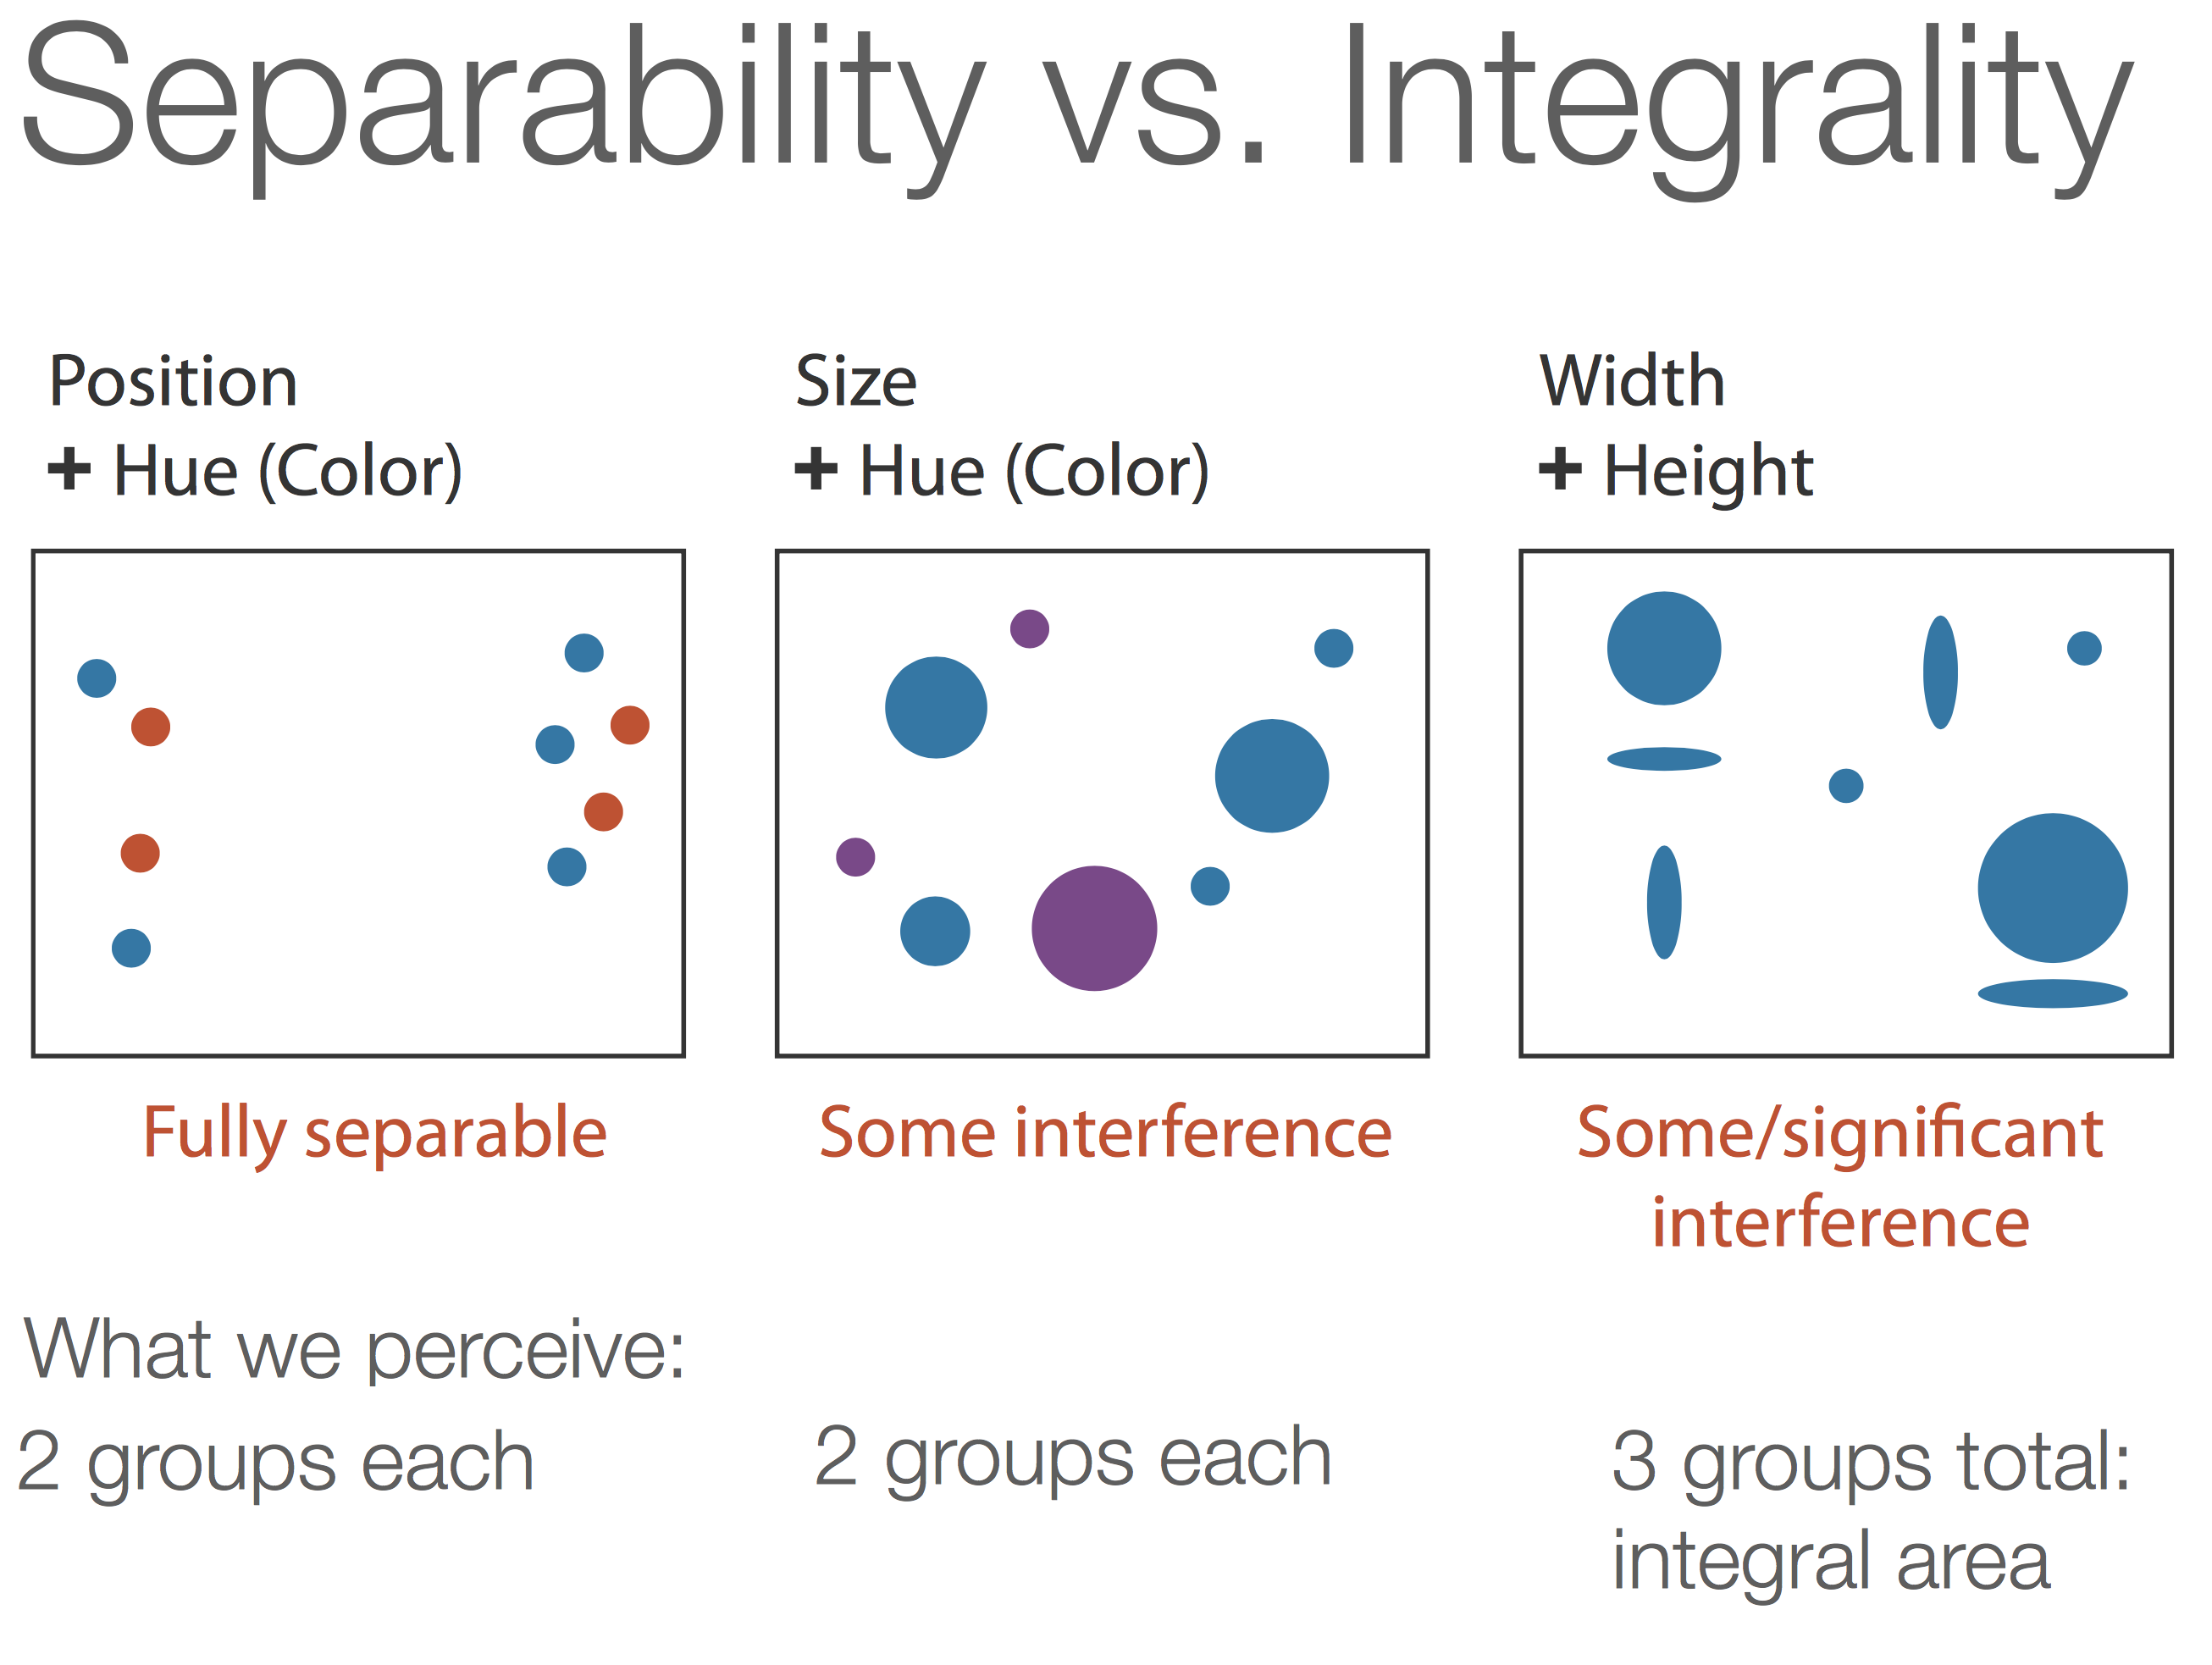

Slide 61
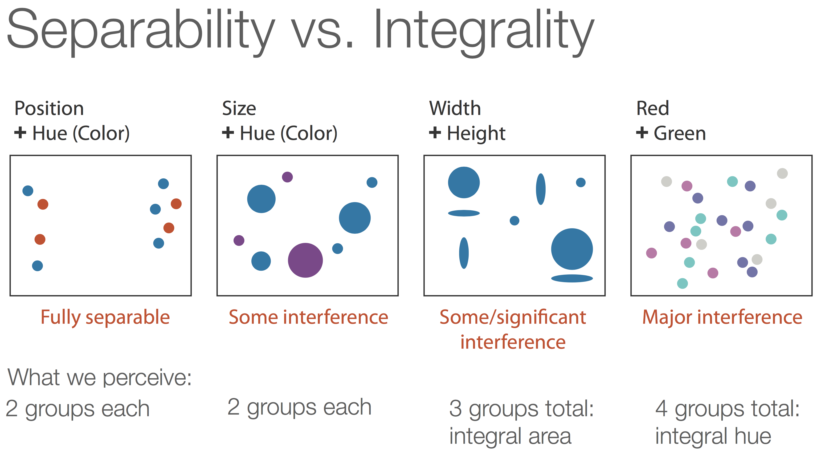

Slide 66
Notes:
NO3 – Nitrate
SO4 - Sulfate

Slide 84
Notes:
Tufte (1990) claims that often ready made graph paper comes with darkly printed lines. The reverse unprinted side should be used, for the lines show through faintly and do not clutter the data.

Slide 85
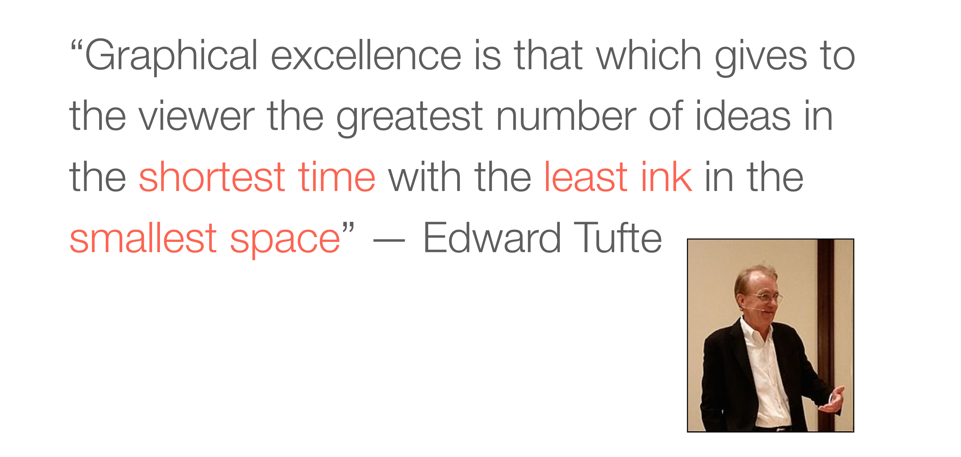

Slide 91
Notes:
Change blindness is a perceptual phenomenon that occurs when a change in a visual stimulus is introduced and the observer does not notice it. For example, observers often fail to notice major differences introduced into an image while it flickers off and on again.

Slide 93
Awareness Test

Slide 95
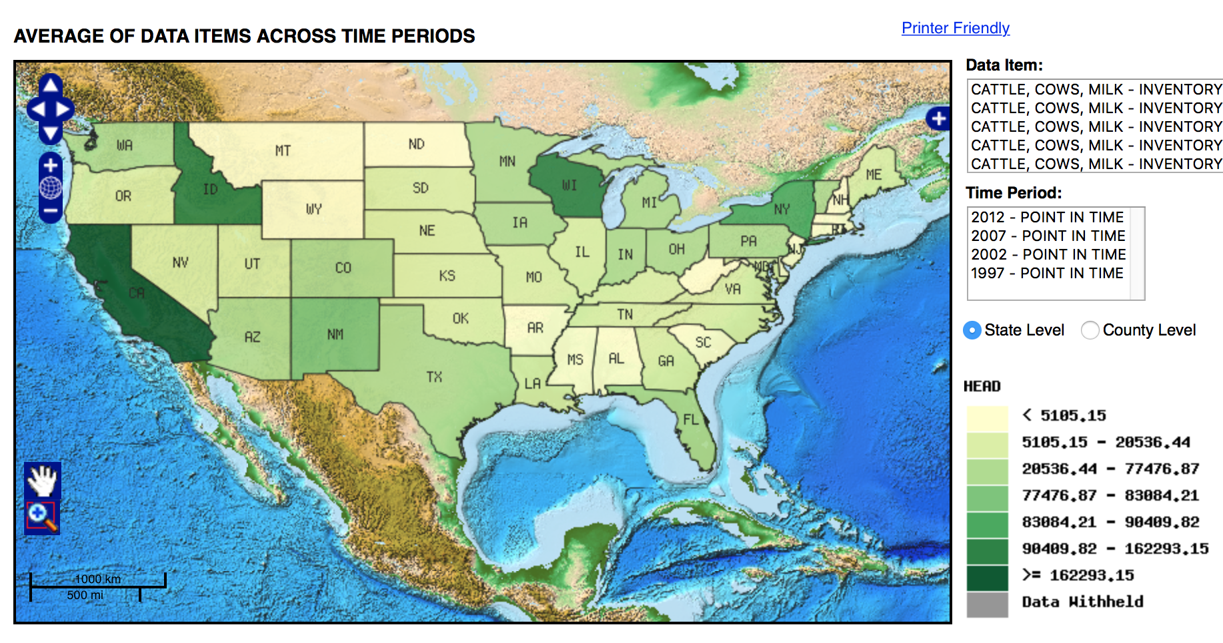

Slide 96
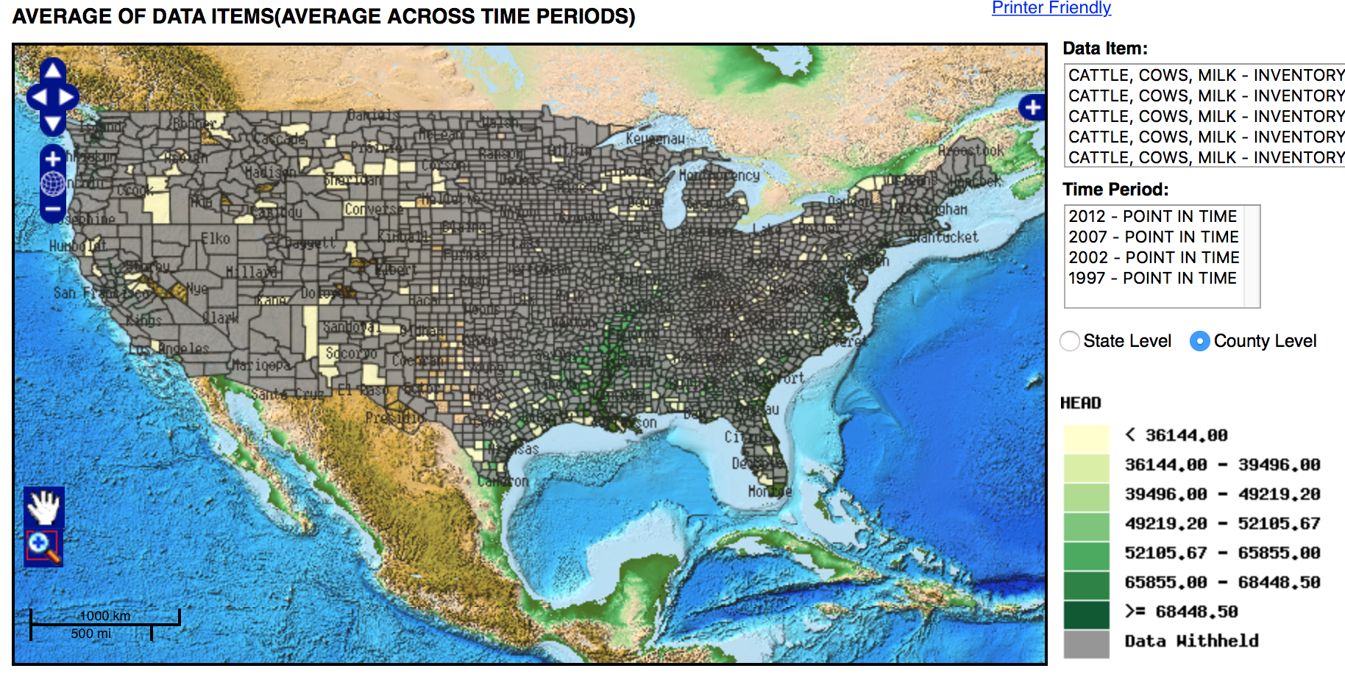

Slide 97
